Slide 1
Poster Layout Landscape Mode Recommended
Easychair
Submission
Number
POSTER TITLE
Logo of Affiliated Institute
Track No
Author Details and Affiliations
Track Number of your submission
Submission Number in Easychair
India Management Research Conference
December 7 – 9, 2024 | Indian Institute of Management, Ahmedabad

Slide 2
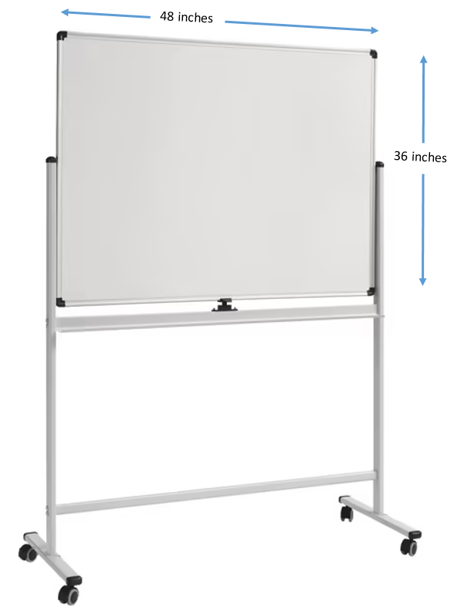
Guidelines for Poster Presentation
The recommended size of the poster is A0 (1189 x 841 mm, H x W) or A1 (594 x 841 mm, H x W) paper size in landscape mode.
The title of the paper, author’s names and affiliation should be printed at the top of the poster. (Refer to the template)
Please ensure to make your poster visually appealing. For instance, replicating the text of your abstract onto the poster is not recommended. Instead, strive to have a continuous flow of ideas through numbers, figures, diagrams, and graphs.
You shall be provided with a Poster mounting board (Whiteboard W-48 inches x H-36 inches) as shown in the attachment with clips/Tape, a table, and a chair. (The exact location of your poster will be communicated later.)

Slide 3
IMRC Related Logos
Logo Images are available on the following Google Drive Folder
https://drive.google.com/drive/folders/1a5ntd5OpYQN06p-g3zIK1hr28N4hRkZl?usp=sharing

